Slide 1

Note: The data and information in this document is reflective of a hypothetical situation and client. This document is to be used for KPMG Virtual Internship purposes only.
Sprocket Central Pty Ltd
Data analytics approach
[VAN DUONG NGO]

Slide 2
Note: The data and information in this document is reflective of a hypothetical situation and client. This document is to be used for KPMG Virtual Internship purposes only.
Agenda
Introduction
Data Exploration
Model Development
Interpretation

Slide 3
Note: The data and information in this document is reflective of a hypothetical situation and client. This document is to be used for KPMG Virtual Internship purposes only.
Introduction
The parts in the analysis:
Comparison between the “Old” and the “New” customers, in regard to the attributes as follow:
- Age Distributions
- Job Industry Distributions
- Wealth Segmentation by Age Category
The Bike Related Purchases over the past 3 years by Gender
The Number of Cars that are owned or not owned in each State
RFM (recency, frequency, monetary) analysis and customers’ purchasing behavior prediction

Slide 4
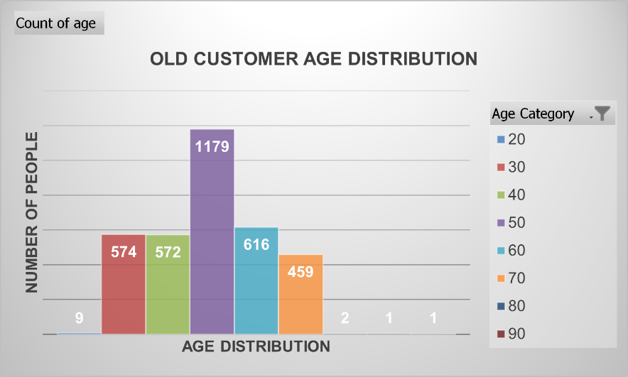
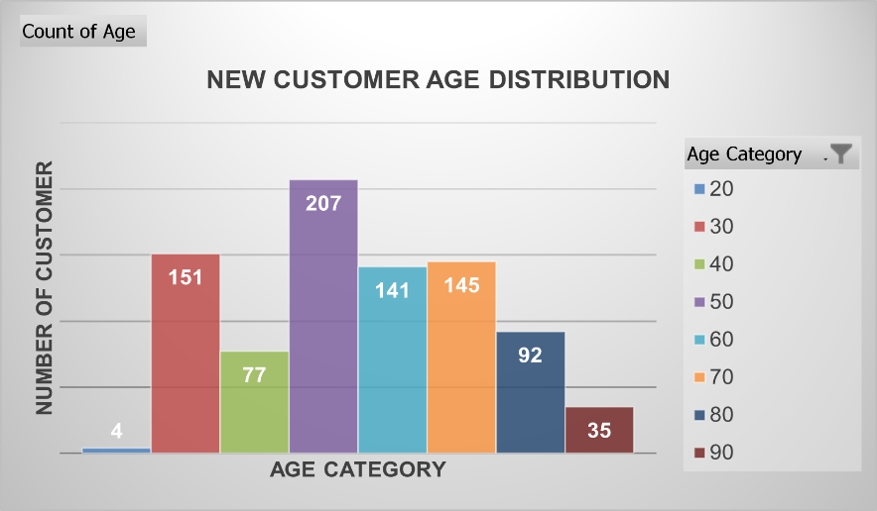
Note: The data and information in this document is reflective of a hypothetical situation and client. This document is to be used for KPMG Virtual Internship purposes only.
Data Exploration
AGE DISTRIBUTIONS OF
NEW AND OLD CUSTOMERS
The company's customers are mainly in the age group from 40 to 49 (1179 people for old list and 207 for new list)
The youngest age group is the group with the fewest customers
While very few customers in the old customer list belong to the oldest age group (80s and 90s group), the new customer list shows that these age groups are holding a lot of potential.
The groups aged to 30, 40, 60 and 70 still hold a significant position. In particular, in the list of new customers, there is not a big difference between these groups and the largest group

Slide 5
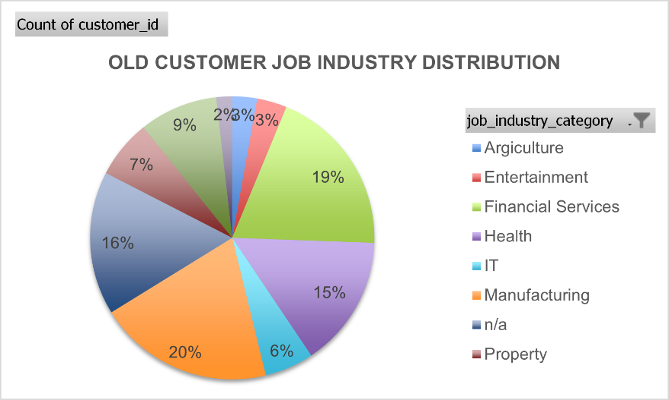
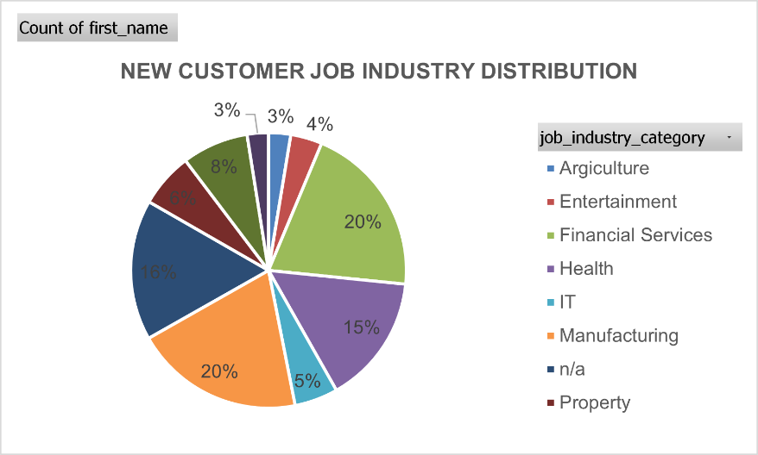
Note: The data and information in this document is reflective of a hypothetical situation and client. This document is to be used for KPMG Virtual Internship purposes only.
Data Exploration
JOB INDUSTRY DISTRIBUTIONS OF
NEW AND OLD CUSTOMERS
Financial Services and Manufacturing Industry respectively rank the 1st and 2nd position regarding the job industries with the most customers (from 10% to 20%). In contrast, Agriculture and Entertainment are the industries with the fewest customers (around 3 or 4%)
In general, there is not too much difference in the number of customers working in job industries between the two lists of customers. When implementing marketing plans, groups with an average number of customers such as Health, IT, and Property should also be given considerable attention.

Slide 6
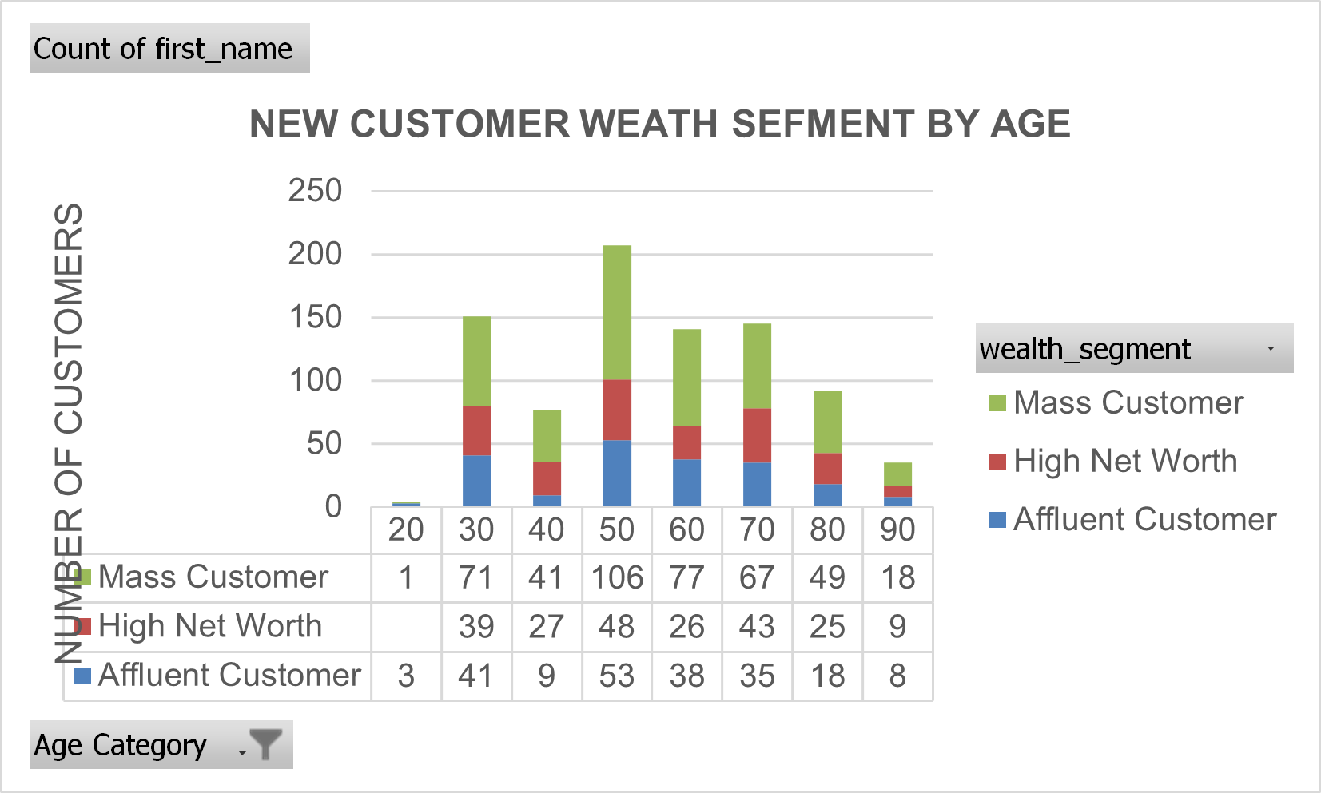
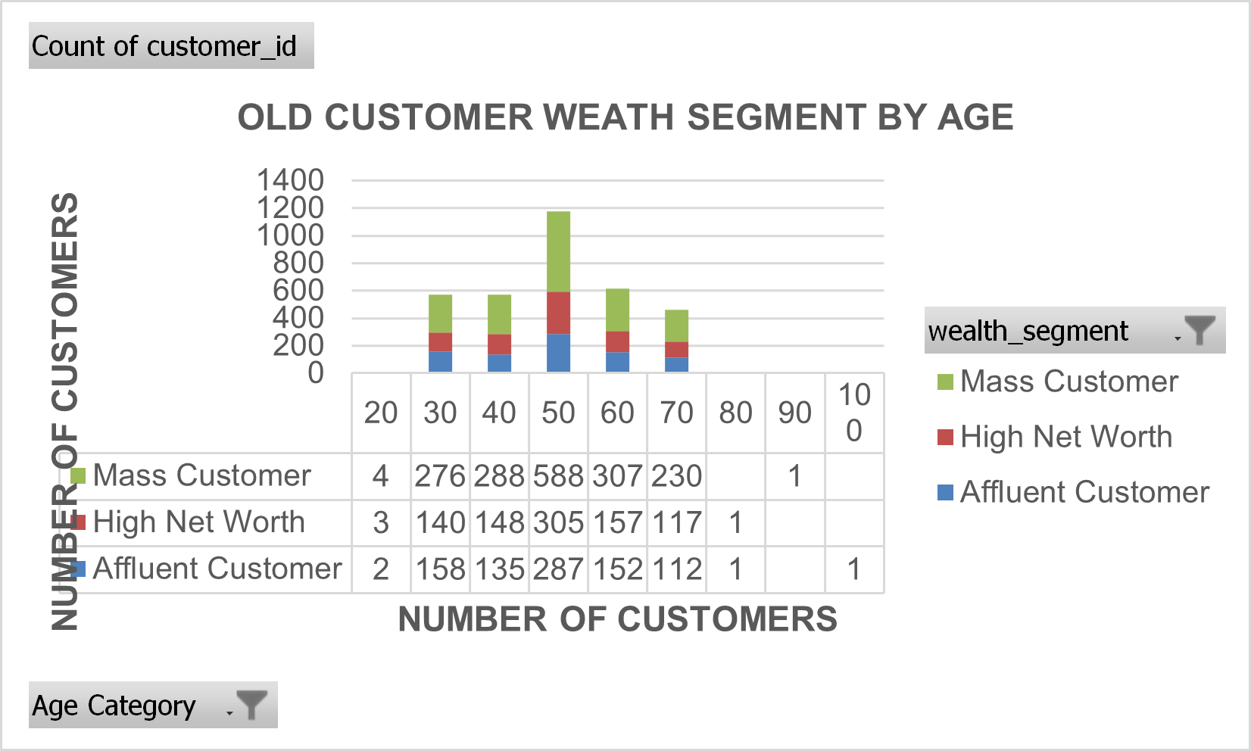
Note: The data and information in this document is reflective of a hypothetical situation and client. This document is to be used for KPMG Virtual Internship purposes only.
Data Exploration
WEALTH SEGMENTATION
BY AGE CATEGORY
In the largest age group (from 10 to 49) in both lists, the most customers belong to Mass Customer. High Net Worth and Affluent Customer have similar numbers of customers, and only half the figure of Mass Customer.
General trend is that Mass Customer takes a significant proportion in each age category

Slide 7
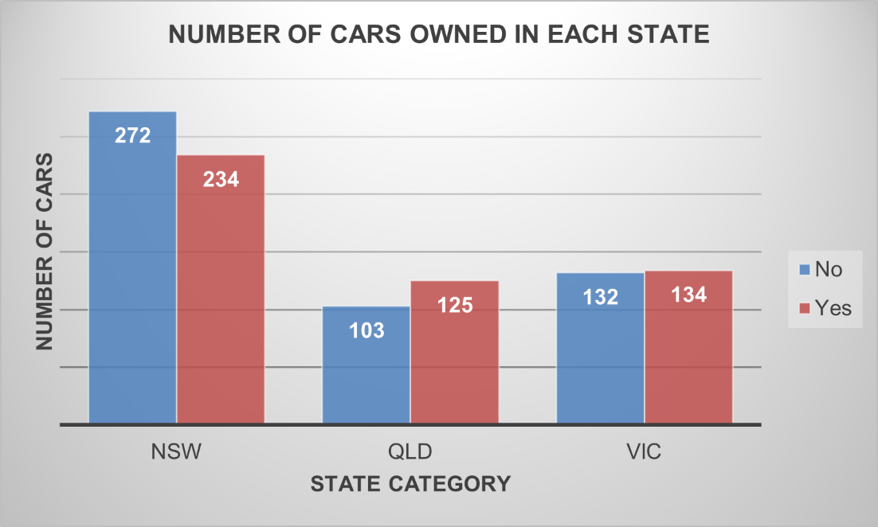
Note: The data and information in this document is reflective of a hypothetical situation and client. This document is to be used for KPMG Virtual Internship purposes only.
Data Exploration
THE NUMBER OF CARS OWNED IN
EACH STATE
New South Wales is the state which customers owned the most car with 234 units, remarkably higher than two other states (Queensland – 125 cars and Victoria – 134 cars)
While in New South Wales, the number of cars owned is higher than the figure for non-owned, the opposite trend is in Queensland and Victoria State. However, the gap is not too big

Slide 8
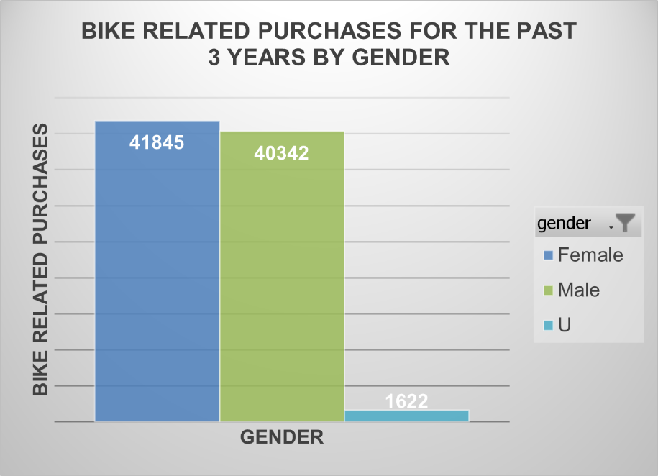
Note: The data and information in this document is reflective of a hypothetical situation and client. This document is to be used for KPMG Virtual Internship purposes only.
Data Exploration
THE NUMBER OF BIKE RELATED PURCHASES OVER THE PAST 3 YEARS BY GENDER
There is a higher number of bike related purchases done by female (41845) than male (40342).

Slide 9
Note: The data and information in this document is reflective of a hypothetical situation and client. This document is to be used for KPMG Virtual Internship purposes only.
Data Development
RFM ANALYSIS
What is RMF? - RFM segmentation is the tool that allows to target specific clusters of customers with communications that are much more relevant for their particular behavior – and thus generate much higher rates of response and plus increased loyalty. RFM segmentation identifies groups of customers for special treatment, based on recency, frequency and monetary
- Recency: How much time has elapsed since a customer’s last activity or transaction with the brand?
- Frequency: How often has a customer transacted or interacted with the brand during a particular period of time?
- Monetary: Also referred to as “monetary value,” this factor reflects how much a customer has spent with the brand during a particular period of time.
RFM Analysis in the database: Using a scale from 1 to 4 to identify the level of the above attributes:
- Recency: 1 – Most recent purchase; 4 – Last purchase long ago
- Frequency: 1 – Purchase least frequently; 4 – Purchase most frequently
- Monetary: 1 – Spend little; 4 – Spend the most

Slide 10
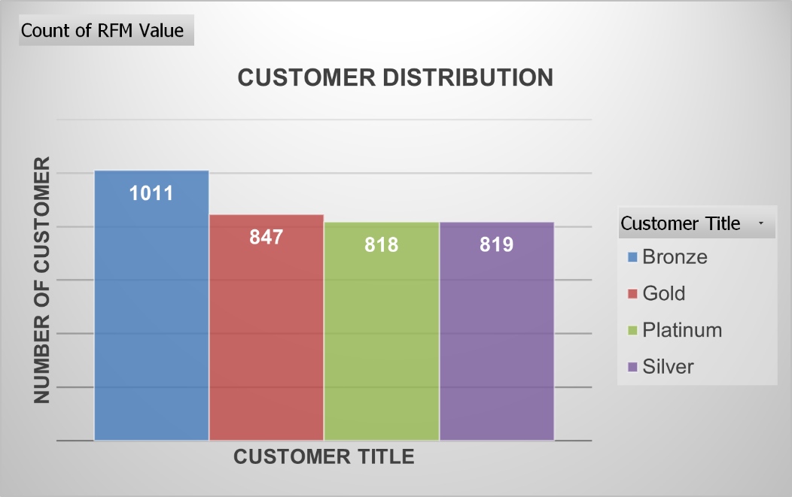
Note: The data and information in this document is reflective of a hypothetical situation and client. This document is to be used for KPMG Virtual Internship purposes only.
Data Development
RFM RESULT FOR THE DATABASE
Using quartiles to define the scales for each attribute, codes are then generated to determine customer loyalty. Specifically: 444 - customers who buy most recently, most often and spend the most; 111 - customers have the longest last purchase, buy the least often, and consume the least.
There are 4 types of customer title that is identified respectively: Platinum, Gold, Silver, Bronze
The largest customer group is the Bronze group (1011 people). The most preferred customer group (Platinum) is the customer group with the fewest members with only 818 people, 1 person less than the Silver group. Gold group ranked second with 847 people

Slide 11
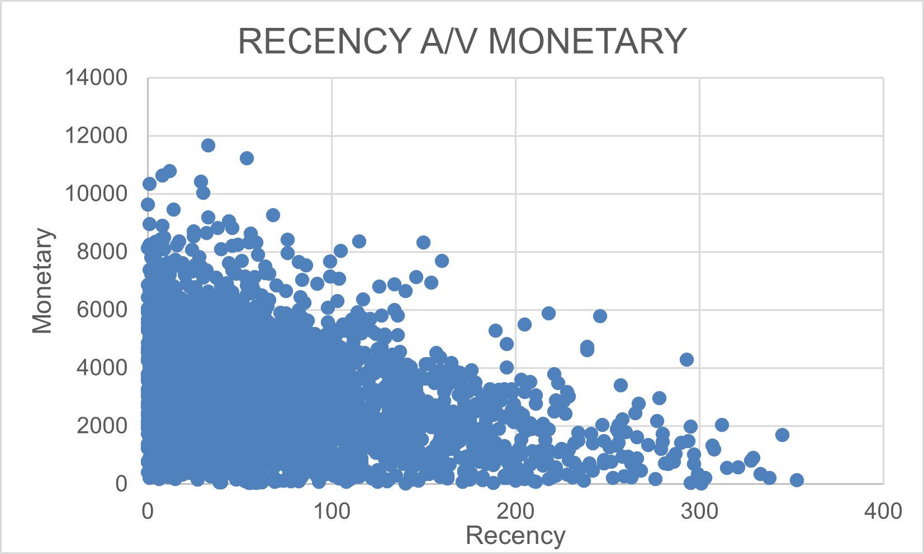
Note: The data and information in this document is reflective of a hypothetical situation and client. This document is to be used for KPMG Virtual Internship purposes only.
Data Development
CUSTOMER’S PURCHASING BEHAVIOUR ANALYSIS
In general, it is easy to see that Recency and Monetary have a negative relationship. Customers who purchased most recently bring more revenue to the company than customers who have last purchases for a long time ago.
Customers purchased less than 100 days ago spent more money than people buying over than 200 days

Slide 12
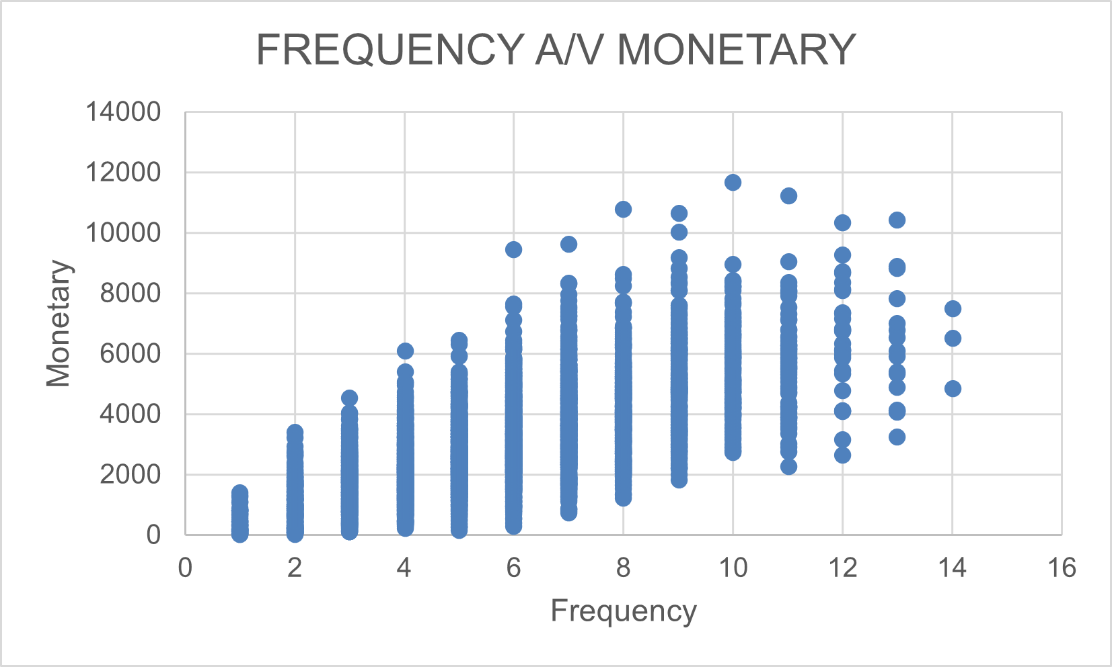
Note: The data and information in this document is reflective of a hypothetical situation and client. This document is to be used for KPMG Virtual Internship purposes only.
Data Development
CUSTOMER’S PURCHASING BEHAVIOUR ANALYSIS
The relationship between Frequency and Monetary is quite complicated. Specifically, customers tend to spend money increasing gradually from the 1st to the 10th time. However, there is a decrease in the amount per purchase after 10 purchases.
However, it can be seen that, customer spent over 8000$ tend to buy more frequently (usually from 6 to 13 times)

Slide 13
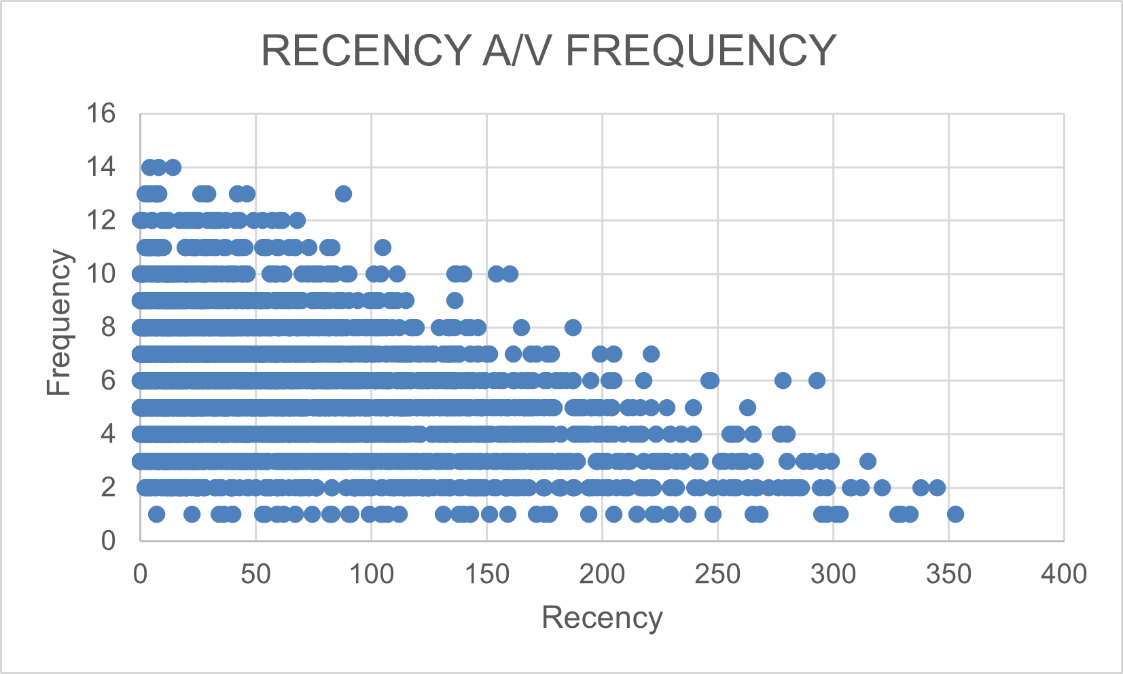
Note: The data and information in this document is reflective of a hypothetical situation and client. This document is to be used for KPMG Virtual Internship purposes only.
Data Development
CUSTOMER’S PURCHASING BEHAVIOUR ANALYSIS
There is a negative relationship between Recency and Frequency. It means the more recently people come to buy items, the more frequently they have visited for purchases.
For example, customers having a low frequency level (2 times) bought something from around 350 days ago. Meanwhile, people with 14 times of purchase have the most recently purchase date (under 50 days)

Slide 14
Note: The data and information in this document is reflective of a hypothetical situation and client. This document is to be used for KPMG Virtual Internship purposes only.
Interpretation
Based on the above analysis, in 1000 new customers, people with the following characteristics should be targeted to drive the most value for the organization:
Demographic characteristics:
- Aged from 21 to 70
- Working in Financial Service and Manufacturing industry
- Lives in New South Wales
- Focus on all genders and wealth segmentation
Customer Trends and Behavior:
- The customers who bought the most recently and spent the most money
- Recent purchases under 100 days with a frequency of less than 10 purchases
- Customers who shop with the frequency from 6 to 12 times and use the most money in each shopping time

